Slide 1
NURTURING THE TRUST
OF THOSE WE LEAD
E. LeBron Fairbanks
September 2019
Notes:
NURTURING TRUST. INSPIRING CONFIDENCE. STRENGHENING CREDIBILITY. WHEN PASTOR JUBILEE AND I DISCUSSED SEVERAL POSSIBLE THEMES TO ADDRESS IN THIS EVANGELICAL ALLIANCE SEMINAR, I SUGGESTED WE FOCUS ON CHAPTER SIX AROUND THE THEME, “NURTURING THE TRUST OF THOSE WE LEAD,” HE IMMEDIATELY AND ENTHUSIASTICALLY RESPONDED, “YES, WE NEED TO DISCUSS THIS THEME.” IF TIME PERMTTED, WE COULD TALK ABOUT “TRUSTING GOD.” SO VERY IMPORTANT. ALSO, WE COULD EXPLORE THE NEED AS LEADERS TO DEVELOP OUR TRUST IN OTHERS. BUT IT IS THIS THIRD COMPONANT OF TRUST, OF “NURTURING THE TRUST OF THOSE WE LEAD” THAT SEEMS TO ME BE BE LACKING IN OUR DISCUSSION.

Slide 2
As Christian leaders,
we can serve as decisive and faithful leaders
with integrity and grace
as our testimony of faith
and growth in grace
continually transform the way
we live in and lead our faith communities.
Notes:
AS WE LEAD OTHES IN OUR COMMUNITIES OF FAITH AND MINISTRY ORGANIZATIONS, WHAT DOES OUR FAITH SAY ABOUT THE WAY WE LEAD? WHAT SHOULD BE THE DIFFERENCE IN THE WAY WE LEAD AS CHRISTIANS AND THE WAY NON-BELIEVERS LEAD THEIR ORGANIZATIONS? IN THE EPILOGUE OF THE BOOK I MAKE THIS STATEMENT. READ SLIDE.

Slide 3
The people we serve should witness in us a transformed and transformative spirit, reflected in the occasions of our disagreements, and in the ways we plan and process important issues.
Notes:
READ THE ABOVE STATEMENT. “A TRANSFORMED AND TRANSFORMATIVE SPIRIT…NOT JUST TRANSACTIONAL, OR GIVING INFORMATION, OR TELLING US WHAT WE SHOULD AND SHOULD NOT DO. ESPECIALLY WHEN GOOD AND GODLY PEOPLE DISAGREE OVER VISION, VALUES, PROGRAMS GOALS AND TRADITIONS.(TO BE DISCUSSED THIS AFTERNOON))

Slide 4
Those whom we lead should see no separation between the sacred and secular in our lives. No great divide between the message we preach and the way we lead. No inconsistency. No manipulation. No disrespect. No abuse. No significant gap between our words and our deeds.
Notes:
WHAT ARE THE KEY WORDS AND/OR KEY PHRASES FOR YOU IN THIS STATEMENT?

Slide 5
The way we preach on Sunday,
live in the home, work in the community,
and lead a board meeting on Tuesday evening
should give evidence to an increasing
“conformity to the mind of Christ.”
II Corinthians 3:18
Notes:
I CONCLUDE MY WORDS OF THE EPILOGUE WITH THESE WORDS. READ SLIDE. THIS SCRIPTURAL PASSAGE IS A KEY BIBLCAL PASSAGE FOR LIVING AND LEADING, ESPECIALLY IN TIMES OF CONFLICT.

Slide 6
"Many people claim to be loyal, but it is hard to find a trustworthy person.”
Proverbs 20:6 (NCV)
Is this passage still true today? Of others? Of us?
Of the faith communities, local congregations,
and ministry organizations we lead?
How can we lead in such a way that those we lead say,
“I deeply trust you?”
Notes:
We read and hear these words often, “Trust us” Trust is everything” However, IN THE OLD TESTAMENT, KING SOLOMAN STATES THAT "Many people claim to be loyal, but it is hard to find a trustworthy person.” AKS QUESTIONS ABOVE.
Ask last question (ABOVE). GIVE AND ASK FOR PERSONAL ILLUSTRATIONS OF WHEN A PERSON WE LEAD SAID TO US, “I TRUST YOU DEEPLY.” WHY WOULD PEOPLE SAY THESE WORDS TO US?

Slide 7
Five “Growth-producing” questions related to trust
“Do I do what I say I will do…consistently?”
“Am I honest with others and seek their best in conversations with them…and about them?
“Do I speak directly to those who differ with me and do I hold these conversations confidentially?”
4. “Do I have the ability to do what I say I can do, and do it well?”
“Am I a leader whose presence others welcome or dread?”
If TRUST is the foundational building block of a decisive and faithful
leader, then what are some TRUST-DEVELOPING
Leadership Qualities I need to nurture?
Notes:
WE NURTURE THE TRUST OF THOSE WE LEAD AS WE INTENTONALLY ANSWER THESE QUESTIONS. THESE QUESTONS FORM THE OUTLINE OF SOME
SPIRIT-EMPOWERED, TRANSFOMATIVE QUALITIES OF A DECISIVE AND FAITHFUL LEADER!

Slide 8
The Qualities of Integrity and Consistency.
2. The Qualities of Communication and Transparency.
3. The Qualities of Confidentiality and Courageous Conversations.
4. The Qualities of Credibility and Humility.
5. The Qualities of Presence and Caring Relationships.
SPIRIT-EMPOWERED,
trust-developing Qualities
of a decisive and faithful leader
Notes:
LET’S EXPLORE THIS THEME IN OUR SESSIONS TODAY. How specifically does our growth in grace continually transform the way we live in and lead our faith communities as it relates to: …the qualities of integrity and consistency? …the qualities of communication and transparency …the qualities of confidentiality and courageous conversations?
…the qualities of credibility and humility?…the qualities of presence and caring relationships?
IF POSSIBLE, READ CHAPTER SIX, ESPECIALLY THE FIRST SECTION ON “THE FOUNDATIONAL QUALITY OF TRUST. I PLAN TO BUILD UPON THE MATERIAL IN THE BOOK, WERE I FOCUS ON INTEGRITY, COMPENTENCY, AND REFLATIONSHIPS.

Slide 9
Nurturing the trust of those we lead
1
The Qualities of Integrity and Consistency.
“Do I live the way I say I live…consistently?”
“Do I do what I say I will do…consistently?”
“Christian leader when asked, “how do you want to be remembered,” replied, “…as man of integrity.…a consistency between my public and private life. A complete person.”
Notes:
IS THERE A GAP IN YOUR LEADERSHIP INTEGRITY AND CONSISTENCY? IF SO, RATE YOURSELF ON A SCALE OF #1 TO #2. (#1 IS VERY LOW; #5 IS VERY HIGH)
QUOTE FROM A GREAT GLOBAL CHRISTIAN LEADER. When asked, “HOW DO YOU WANT TO BE REMEMBERED?” He replied “Here lies a man of integrity.” He BELIEVED THAT the greatest COMPLIMENT for a Christian LEADER is to be known as a person of of integrity…a CONSISTENCY BETWEEN OUR BETWEEN OUR PUBLIC AND PRIVATE LIVES. A whole person. A complete person.”

Slide 10
Focus on Integrity and Consistency.
How do you define Integrity?
Honesty, consistency. The same inside and outside.
(It is the #1 trait people want in leaders)
From a biblical viewpoint….
To live in light of what is important to God.
We live our lives consistent with what we profess by faith.
Notes:
Integrity: honesty, consistency, and coherency. The basic element of Christian character. The same inside and outside. It is the #1 trait people want in leaders.”
From a biblical viewpoint, it has to do with being morally sound,…to know what is important to God and consistently lives in light of what is important to Him.” To live our lives consistent with what we profess by faith.
Philippians 2:5-8 “Your attitude should be the same as that of Jesus Christ…taking the very nature of a servant…he humbled himself….”

Slide 11
Focus on Integrity and Consistency.
Five questions have helped me in my pursuit of Integrity
Will this action I am considering strengthen me spiritually?
Would I want my son, my wife, or my best friend to copy this action of
mine?
Does this action violate a biblical principle?
Does this action strengthen the body of Christ?
Would an unbelieving friend be attracted to Christ and the Christian
faith by my behavior?
Integrity Counts. Really counts!
Notes:
“And David shepherded them with integrity of heart; with skillful hands he led them.” Psalms 78:72 (NIV)
“May integrity and uprightness protect me, because my hope is in you.” Psalms 25:21
“Who ever can be trusted with little can be trusted with much, and whoever is dishonest with very little will be dishonest with much. Luke 16:10
What kind of people ought you to be? You ought to live holy and godly lives” II Peter 3:11-12
Illustration. Group discussion question.

Slide 12
Focus on Integrity and Consistency.
Psalms 78:72 (NIV)
Psalms 25:21
Luke 16:10
II Peter 3:11-12
“In the future, only integrity matters. Without integrity, there is no future.”
Illustration: Daughter’s conversations with her father.
”Dad, you promised me you were going to clean this up,” she said. “You’re writing a book
about words, but you don’t keep your word.”
Integrity: who we are when no one else is around.
Integrity: who we are in the pressure times of our lives.
Notes:
“And David shepherded them with integrity of heart; with skillful hands he led them.” Psalms 78:72 (NIV)
“May integrity and uprightness protect me, because my hope is in you.” Psalms 25:21
“Who ever can be trusted with little can be trusted with much, and whoever is dishonest with very little will be dishonest with much. Luke 16:10
What kind of people ought you to be? You ought to live holy and godly lives” II Peter 3:11-12
Character or Reputation? See text Chapter Three
Illustration. Group discussion question.

Slide 13
Self-evaluation questions regarding
Integrity and consistency
1. “Is my behavior predicable or erratic?
2. Do I communicate clearly or carelessly?
3. Do I treat promises seriously or lightly?
4. Am I honest or dishonest?” (Credibility, p.108-9)
5. Do I keep conversations confidential or do I “gossip”?
6. Why do the people I lead trust or distrust me?
Notes:
PERHAPS A BRIEF “SELF EVALUATION” WILL HELP US REFLECT ON “INTEGRITY AND CONSISTENCY” in everyday life and work..
IN YOUR MIND OR ON A SHEET OF PAPER, CHOOSE THE WORD THAT CHARACTERIZES YOU AT YOUR BEST? THE WORD THAT reflects where you NEED TO GIVE MORE ATTENTION IN YOUR LIFE?

Slide 14
nurturing the trust of those we lead
2
The Qualities of
Communication and Transparency
“Am I honest with others and seek their best
in conversations with them and about them?”
"Do not lie…speak truthfully…! Speak only what builds others up, according to their needs, that it may benefit those who listen.”
Ephesians 4:25, 29
Notes:
“Therefore each of you must put off falsehood and speak truthfully to his neighbor, for we are members of one body…Do not let any unwholesome talk come out of your mouths, but only what is helpful for building others up according to their needs, that it may benefit those who listen.” Ephesians 4: 25, 29
“What is the goal of my conversations with others with whom I live and work?”

Slide 15
Focus on Communication and Transparency
Speaking the truth in love*
Ephesians 4:16, 25-32
Four motivations
Four commands
Four prohibitions
“God is grieved when….” Ephesians 4:30a
“Be imitators of God, therefore…and live a life of love….” Ephesians 5:1-2
*See Text, Chapter Two. Figure 2.1. “A Communication Model”
Notes:
IMPORTANT to discuss FIGURE 2.1 in text

Slide 16
Focus on Communication and Transparency
Questions to consider from Ephesians 4:29:
1. Do I speak more negatively than positively?
2. Do I respond quickly before I have all the facts?
3. Do I talk about people behind their backs, saying things I would not say to them?
4. Do I stress unimportant issues?
5. Do I make excuses?
6. Do I avoid reality questions?
What are “Unfair Communication Techniques”?
Notes:
Back to Ephesians 4:29. Discuss “Unfair Communication Techniques” (text) from Wahlroos, Sven. Family Communication. McGraw-Hill/Contemporary Books, Revised edition, 1995. Silence, ignoring, sulking, pouting, cold shoulder treatment? Sarcasm and ridicule? Unfavorable comparisons? Discussing private conversations in public? Blaming the person for something which he/she cannot help or cannot do anything about? Intimidating, yelling, exploding? Bragging? Nagging, whining/crying?

Slide 17
Focus on Communication and Transparency
As leaders, through the words we use, we:
Encourage or discourage…
Lift them up or put them down…
Speak positively or negatively…
Focus on “them” or focus on self.
Discussion: How have I been “blessed” or “hurt” by words?
Notes:
READ SLIDE. ASK QUESTION FOR GROUP DISCUSSON.

Slide 18
Nurturing the trust of those we lead
3
The Qualities of Confidentiality and Courageous Conversations
“Do I speak directly to those who differ with me and
do I hold these conversations confidentially?”
“A gossip ….” Proverbs 11:13
Jesus: Matthew 5:37
Paul: “Speak the Truth in Love” Ephesians 4: 15
Paul: “Do not let the sun go down on your anger.” Ephesians 4:26-27.
Notes:
“A gossip betrays a confidence but a trustworthy man keeps a secret.” Proverbs 11:13
Jesus: “Let your ‘yes’ be ‘yes’ and your ‘no, ‘no.’” Matthew 5:37
Ephesians 4:15 “Instead, speaking the truth in love, we will grow to become in every respect the mature body of Him who is the head, that is, Christ.”
“Do not let the sun go down on your anger. In your anger do not sin. Do not Satan get a foothold in your lives.” Ephesians 4:26-27.

Slide 19
Focus on Confidentiality and Courageous Conversations
“Vigorously discuss policy options and
make decisions within board meetings! Or Family. Or Church.
Communicate board action outside of board meetings
with unified support! Accept board decisions...! (“It’s OK!”)
Keep confidential conversations,
CONFIDENTIAL!
“Guard your heart and guard your word!”
Notes:
Guidance from Ephesians regarding WHEN we are to engage in “courageous conversations?”. Remember Context of Ephesians 4:26-27: “ In your anger do not sin. Do not let the sun go down while you are still angry, and do not give the devil a foothold.” Prior verse:: Verse 25: “THEREFORE EACH OF YOU MUST PUT OFF FALSEHOOD AND SPEAK TRUTHFULLY TO YOUR NEIGHBOR, FOR WE ARE ALL MEMBERS OF ONE BODY.” FOLLOWING VERSES: VERSE: 28: ANYONE WHO STEALS MUST STEAL NO LONGER…” VERSE 29: “DO NOT LET ANY UNWHOLESOME TALK COME OUT OF YOUR MOUTHS, BUT ONLY WHAT IS HELPFUL IN BUILSING OTHERS UP ACCORDING TO THEIR NEEDS, THAT IT MAY BENEFIT THOSE WHO LISTEn.” Also: Ephesians 4: 1-3. Need for reconciliation within the fellowship before proclamation of the need outside the fellowship

Slide 20
Focus on Confidentiality and Courageous Conversations
Questions regarding “courageous conversations”
Does what I say build up or tear down the other person?
Would I say what I am saying directly to the person involved?
Do I know all the facts or am I responding on the basis of half-truths, partial facts or limited information?
Is my response triggered more by emotion than by reason?
Is the issue really deserving the energy that I am giving it?
Can the situation be seen from a different perspective?
Notes:
ROMANS 15:7 “ACCEPT ONE ANOTHER, THEN, JUST AS CHRIST ACCEPTED YOU, IN ORDER TO BRING PRAISE TO GOD.”
GROUP DISCUSSION: WHEN WAS IT NECESSARY TO “SPEAK TRUTHFULLY AND COURAGEOUSLY” TO A PERSON YOU LEAD? RESULT(S)?

Slide 21
Focus on Confidentiality and Courageous Conversations
Insights on “courageous conversations” from Romans 15:7
1. Good and godly people often see things differently.
2. Many issues over which we experience conflict are culturally, ethnically, local community, even family-based,
and not a violation of scripture.
3. Differences that divide us have the potential to alienate members of the body of Christ and to impact negatively the work of God.
4. Respecting those who differ with us is to love them
as God loves them.
5. Acceptance of others implies that we can learn from them.
Notes:
ROMANS 15:7 “ACCEPT ONE ANOTHER, THEN, JUST AS CHRIST ACCEPTED YOU, IN ORDER TO BRING PRAISE TO GOD.”
Read the five insights.
GROUP DISCUSSION: WHEN WAS IT NECESSARY TO “SPEAK TRUTHFULLY AND COURAGEOUSLY” TO A PERSON YOU LEAD? RESULT(S)?

Slide 22
Focus on Confidentiality and Courageous Conversations
GROUP DISCUSSION:
REVIEW THE GUIDANCE IN EPHESIANS 4
REGARDING WHEN
WE MUST ENGAGE IN
“COURAGEOUS CONVERSATIONS!
Notes:
EPHESIANS 4:1; 2-3; 3; 7; * 12-13, 14-16*. 17ff; *25; 26-17; 29; *30; 31-21. **5:1-2

Slide 23
Nurturing the trust of those we lead
4
The Qualities of Credibility and Humility
“Do I have the ability to do what I say I can do,
and do It well?”
Colossians 3:23 “Whatever you do, work at it with all your heart…”
Philippians 2:3 “In humility, value others above yourselves…”
Proverbs 11:2 “…with humility comes wisdom.”
Notes:
PHILIPPIANS 2:3 “DO NOTHING OUT OF SELFISH AMBITION OR VAIN CONCEIT. RATHER, IN HUMILITY VALUE OTHERS ABOVE YOURSELVES, NOT LOOKING TO YOUR OWN INTERESTS BUT EACH OF YOU TO THE INTERESTS OF OTHERS.” “
COLOSSIANS 2:3 WHATEVER YO DO, WORK AT IT WITH ALL YOUR HEART, AS WORKING FOR THE LORD, NOT FOR MAN.”
PROVERBS 11:2 ‘WHEN PRIDE COMES, THEN COMES DISGRACE, BUT WITH HUMILITY COMES WISDOM.’ “

Slide 24
Focus on Credibility and Humility
“What is “credibility”? (See Text)
How do OTHERS perceive me and my trustworthiness?
1. “Is my behavior predicable or erratic”?
2. Do I communicate clearly or carelessly?
3. Do I treat promises seriously or lightly?
4. Am I forthright or dishonest?” (Credibility, p.108-9)
5. Do I keep conversations confidential or do I “gossip”?
6. Why do the people I lead trust or distrust me?
QUESTION: IS THERE A “CREDIBILITY” GAP?
Notes:
“Creditability” a belief, a confidence (trust) that you will do what you say you will do.
“Credit-ability” “People are doing an analysis of our credibility all the time just as a bank might assess our credit worthiness. Indeed, credibility is the working capital of the leader. It is the account of credibility that the leader draws on to make possible creative change.” James Kouzes. (See LD! LF! Text, p.183.)

Slide 25
Focus on Credibility and Humility
Relationship of CREDIBILITY AND “COMPETENCY”?
See text, Chapter Six
Competency: having the necessary skills or qualities to do
what is needed for the assignment.
Those whom we lead “look to us to be able to accomplish what needs to be done. If we consistently fall short, trust will dissolve.”
Text, Chapter Six.
Integrity (consistency between words and deeds)
Competency (the ability to address the organization's needs)
Temptation: Competency may lead to pride.
Notes:
Trust occurs in and from relationships. Integrity (consistency between words and deeds) is vital to building trust, and THEN competency (the ability to address the organization's needs) (BOTH) are necessary for building long-term trust.”
Temptation: A competent person may be tempted to to be proud of what has been accomplished. Why biblical understanding of “humility” is important.

Slide 26
Focus on Credibility and Humility
”A leader’s trust is won very slowly,
but it can be lost quickly.” (See Text)
The Relationship of Competence to Humility
Philippians 2:3
“In humility, value others above yourselves…”
“…with humility comes wisdom.”
Proverbs 11:2
“Wisdom’s instruction is to fear the Lord, and humility comes before honor”
Proverbs 15:33
Notes:
I, as leader, have gifts from the Lord to use in leading others. But I DO NOT HAVE ALL GIFTS NECESSARY for the leadership assignment. I NEED TO GIFTS OF OTHERS IN THE FAITH COMMUNITY to use their gifts. MY responsibility is NOT TO DO IT ALL, BUT TO EQUIP AND ENABLE OTHERS TO SHARE THE VISION AND THE IMPLEMENTATION. This requires competency and humility. The result of these twin qualities produces credibility for the leader.

Slide 27
Focus on Credibility and Humility
“Leadership is a relationship….”
Credibility, pages 52, 254. See also Text
“People want a leader who is trustworthy, is competent,
has a vision of the future and is dynamic and inspiring.” Credibility, page 48
Six Practices of Credibility:
Discover Yourself
Appreciate Constituents
Affirm Shared Values
Develop Capacity
Serve a Purpose
Sustain Hope Credibility, pages 51ff
Notes:
I, as leader, have gifts from the Lord to use in leading others. But I DO NOT HAVE ALL GIFTS NECESSARY for the leadership assignment. I NEED TO GIFTS OF OTHERS IN THE FAITH COMMUNITY to use their gifts. MY responsibility is NOT TO DO IT ALL, BUT TO EQUIP AND ENABLE OTHERS TO SHARE THE VISION AND THE IMPLEMENTATION. This requires competency and humility. The result of these twin qualities produces credibility for the leader.

Slide 28
Focus on Credibility and Humility
Think of a time you followed the direction
of someone WITH CREDIBILITY AND HUMILITY
1. What was the situation?
2. What three of four words would you use to describe how you felt?
3. What leadership action did this person take to get you to want
to perform at your best?
4. How did you feel about working with leaders you admired?

Slide 29
5
The Qualities of Presence and Caring Relationships
“The most important attribute of a leader…is what the leader
brings in his or her presence. And the presence he/she needs is
a non-anxious presence.”
“Let your gentleness be evident to all. Do not be anxious…” Philippians 4:5-6
“Because we loved you so much, we were delighted to share with you not only the gospel of God but our lives as well.” Thessalonians 2:6b-8
Notes:
THE MOST IMPORTANT ATTRIBUTE OF A LEADER IS NOT KNOWLEDGE OR TECHNIQUE BUT WHAT THE LEADER BRINGS IN HIS/HER
PRESENCE. AND THE PRESENCE HE/SHE NEEDS IS A NON-ANXIOUS PRESENCE.” Edwin Friedman Foundation LEADERSHIP IN THE AGE OF THE QUICK FIX: A FAILURE OF NERVES
Philippians 4:5-6 “Let your gentleness be known to all. The Lord is near. Do not be anxious about anything, but in everything, by prayer and petition, with thanksgiving, present your requests to God.”
I Thessalonians 2:6-8: “We were not looking for praise from people…even though as apostles of Christ we could have asserted our authority. Instead, we were like young children among you. Just as a nursing mother cares for her children, so we cared for you. Because we loved you so much, we were delighted to share with you not only the gospel of God but our lives as well.”

Slide 30
Focus on Presence and Caring Relationships
Our character and leadership should clearly reflect God’s character as He personally equips us through His Spirit.
We are conduits of God’s caring or compassion.
“Clothe yourselves with compassion, kindness, humility, gentleness and patience….
Bear with each other and forgive one another…forgive as the Lord forgave you…. And
over all these virtues put on love….Let the peace of Christ rule in your hearts….Whatever
you do…do all in the name of the Lord Jesus…. Colossians 3:3, 12 -15, 17
Notes:
The Age of the Quick Fix: A Failure of Nerves. Edwin Friedman. “Let Your Life Speak” We lead by being. A Spiritual Journey.
Colossians 3:3 ‘SET YOUR MINDS ON THINGS ABOVE, NOT ON EARTHLY THINGS.” 3:12-15 “THEREFORE, AS GOD’S CHOSEN PEOPLE, HOLY AND DEARLY LOVED. C;OTHE YOURSELVES WITH COMPASSION, KINDNESS, HUMILITY, GENTLENESS AND PATIENCE. BEAR WITH EACH OTHER AND FORGIVE ONE ANOTHER IF ANY OF YOU HAVE A GRIEVANCE AGAINST SOMEONE. FORGIVE AS THE LORD FORGAVE YOU. AND OVER ALL THESE VIRTUES PUT ON LOVE, WHICH BINDS THEM ALL TOGETHER IN PERFECT UNITY.” LET THE PEACE OF CHRIST RULE IN YOUR HEARTS, SINCE AS MEMBERS OF ONE BODY YOU WERE CALL TO PEACE. AND BE THANKFUL. 3:17: AND WHATEVER YOU DO, WHETHER IN WORD OR DEED, DO ALL IN THE NAME OF THE LORD JESUS, GIVING THANKS TO GOD THE FATHER THROUGH HIM.

Slide 31
Focus on Presence and Caring Relationships
Some Practical Steps for Cultivating Leadership Presence:
1. Remember the Triune God is present with you. Deuteronomy 31:6
2. Guard your own heart and mind. Proverbs 4: 23
3. Respect and value the other person. Ephesians 4:25
4. Slow down. Listen Intently. Focus on the “others.” James 1:19
5. Follow Jesus’ example. Ephesians 5:1
6. Lead from your knees. II Chronicles 20:12, 15
Notes:
Deuteronomy 31:6 “Be strong and of good courage. Fear not, nor be afraid of them. For the Lord, thy God, He will never leave you or forsake you.”
Proverbs 4:23 “Above all else, guard your hearts….”
Ephesians 4:25c “”…for we are all members of one body.”
James 1:16 “My dear brothers, take not of this: Everyone should be quick to listen, slow to speak and slow to become angry.”
Epjesians 5:1 “Be imitators of God, therefore, and live a life of love, just as Christ loved us and gave Himself up for us….”
II Chronicles 20:12, 15 (v12)” We do not know what to do, but our eyes are upon you.” (v15) “This is what the Lord says, to you…do not be afraid or discouraged…For the the battle is not yours, but God’s.

Slide 32
Focus on Presence and Caring Relationships
Our presence as leaders, particularly in the midst of conflict and stress (including our words, action, thoughts - our behavior – should increasingly reflect the Christ who indwells within us by His Spirit.
Our presence should should reflect His Presence
Remember: it is not the leader’s presence that is most needed.
It is an awareness of His “Always Presence” to lead.
Matthew 1:23
Matthew 28:20
Our “presence” should reflect His Presence
Notes:
Deuteronomy 31:6 “Be strong and of good courage. Fear not, nor be afraid of them. For the Lord, thy God, He will never leave you or forsake you.”
Proverbs 4:23 “Above all else, guard your hearts….”
Ephesians 4:25c “”…for we are all members of one body.”
James 1:16 “My dear brothers, take not of this: Everyone should be quick to listen, slow to speak and slow to become angry.”
Epjesians 5:1 “Be imitators of God, therefore, and live a life of love, just as Christ loved us and gave Himself up for us….”
II Chronicles 20:12, 15 (v12)” We do not know what to do, but our eyes are upon you.” (v15) “This is what the Lord says, to you…do not be afraid or discouraged…For the the battle is not yours, but God’s.

Slide 33
Focus on Presence and Caring Relationships
Think of different leaders you have encountered
from either inside or outside of the Church.
What was it about a leader that made his/her presence welcome?
Have there been leaders whose presence you dreaded
instead of welcomed? Why?
Could there be some who dread your presence?
What can you do to make your presence more welcomed than dreaded?
Do scriptures come to mind that describe the evidence of
the Lord’s leadership as presence?
Notes:
When we ask ourselves which persons in our lives mean the most to us, we often find that those who, instead of giving advice, solutions, or cures, have chosen rather to share our pain and touch our wounds with a gentle and tender hand.
The friend who can be silent with us in a moment of despair or confusion, who can stay with us in an hour of grief and bereavement, who can tolerate not-knowing, not-curing, not-healing, and face with us the reality of our powerlessness, that is the friend who cares.

Slide 34
Focus on Presence and Caring Relationships
Our compassionate heart is
revealed as we enable others
to see what they have not, nor cannot, see in themselves!
”TO BE KIND IS MORE IMPORTANT
THAN TO BE RIGHT.
MANY TIMES, WHAT PEOPLE NEED
IS NOT A BRILLIANT MIND THAT SPEAKS
BUT A SPECIAL HEART THAT LISTENS”
Author unknown
“A NON-ANXIOUS PRESENCE”
.
Notes:
“GRACE TO YOU. GRACE TO YOU. GRACE TO DO THE WILL OF THE FATHER, GRACE, GRACE TO YOU!”
The “evidence” of our leadership is in equipping and enabling others to see what they have not seen in themselves. To be compassionate is not, first of all,
something we do for others, but rather it is discovering with others their divinely given resources and inner qualities.
It is a way of being present with others and standing with them in their times of need. I am slowly coming to see that God wants us to be with others…not to prove that we are valuable to them.

Slide 35
Let’s Review
Five Trust-Building Questions
1. “Do I do what I say I will do…consistently?”
2. “Am I honest with others and seek their best in conversations with them…and about them?”
3. “Do I speak directly to those who differ with me and
do I hold these conversations confidentially?”
4. “Do I have the ability to do what I say I can do, and do it well?”
5. “Am I a leader whose presence others welcome or dread?”

Slide 36
transformative Leadership Qualities:
NURTURING THE TRUST OF THOSE WE LEAD
SUMMARY
The Qualities of Integrity and Consistency.
The Qualities of Communication and Transparency.
The Qualities of Confidentiality and Courageous Conversations.
The Qualities of Credibility and Humility.
The Qualities of Presence and Caring Relationships.
Notes:
Four Relational Questions to Ask and Answer As We Nurture the Trust of Those We Lead.
Question #1 “How can we live together within this diverse Christian community in such way that our relationships are redemptive and a witness to unbelievers of the reconciling work of God in Christ?”
Question #2: “If, ‘in Christ, all things are made new,’ then how does our relationship to Christ convert or transform the way we live and lead in a Christian community of faith?”
Question #3: “In conflict situations, when good and godly people differ and sometimes collide over vision, values, and traditions, how can I lead in these situations, really lead (and serve) with the mind and spirit of Christ?”
Question #4: ”Do my words and actions as a Christian leader increase or decrease the trust level in me of those whom I seek to lead?

Slide 37
Questions. Comments. Group Discussion.
Is there a gap between
my perception of my trustworthiness
and the perception of trust in me by those I lead?
Which of these qualities are most affirmed
by the testimonies of those you lead?
Is the lack of expression of these qualities hindering
your testimony of faith?
“Are there some specific steps I can take to
NURTURE TRUST OF THOSE WHOM I LEAD?”
Notes:
How has growth in grace been evidenced in each of these five qualities?
Which of these qualities are longing for both immediate and long term growth in grace?
3. How is your testimony of faith enhanced by these qualities?
4. Is the lack of expression of these qualities hindering your testimony of faith?
5. Are any of these qualities evidenced inconsistently between the sacred and secular in your life?
6. Which of these qualities are most affirmed by the testimonies of those you lead?

Slide 38
Trust Building Qualities and Christian Leadership
WHAT IS CHRISTIAN LEADERSHIP?
“Christian leadership is humble service to others for
the purpose of enabling them, through teaching and
example, to live their lives under the Lordship of
Christ, to fulfill their ministry to each other,
and their mission in the world.” (ELF)

Slide 39
Questions
Comments
Group discussion

Slide 40
As Christian leaders, “Our testimony of
faith in Jesus Christ and our growth
in grace must increasingly
inform and transform the
way we lead and live
in our and organizations.”
This is how we nurture the trust
of those we lead.
Notes:
AS CHRISTIAN LEADERS, “OUR TESTIMONY OF FAITH IN JESUS CHRIST MUST INCREASINGLY INFORM AND TRANSFORM THE WAY WE LEAD AND LIVE IN A FAITH COMMUNITY”

Slide 41
Closing prayer in groups

Slide 42
SESSION TWO

Slide 43
The Joy and Pain of nurturing the trust of those we lead
SEVEN “ANCHORS”
hold servant leaders steady as
we lead decisively and faithfully
in the tensions and transitions of our
leadership responsibilities.
Notes:
Repeat theme of this session: “Nurturing Trust…in times of tensions and transitions.” The principle is this: How we guide through transitions will build or erode trust.”

Slide 44
THE JOY OF LEADERSHIP
Notes:
As church leaders, we often focus on the joy of leadership. Pastors have the potential to influence change and impact people. We are energized. We experience joy!

Slide 45
THE JOY OF LEADERSHIP
Notes:
A renewed passion for growth and effectiveness grips us. We committed to make it happen! We sense a vision from God for the future of the congregation. The vision is right, we believe.

Slide 46
“Blessed is the LEADER
who is captured by a big,
God-inspired vision!”
Notes:
A vision is necessary for the people we lead. “Blessed is the person who is captured by a big, God-inspired” vision, and is willing to pay the price to see that vision comes true.”

Slide 47
“VISION” has to do
with seeing things clearly and at a great distance.
Notes:
Regarding the “vision” thing, remember that “vision” has to do with seeing things clearly and at a great distance.”

Slide 48
A VISION is a consuming, passionate, and compelling inner picture.
Notes:
A vision is a “consuming, passionate, and compelling inner picture.”

Slide 49
THE PAIN OF LEADERSHIP
Notes:
Two illustrations frame our discussions today regarding tension and transitions faced by the leaders in faith communities.
The “Stick Man” holding tenaciously (and painfully) to both the “preferred future” verses “present realities.” And then...! Something happens! We encounter the “realities of the present.” Finances. Circumstances. Government. But most often, we encounter the “reality” of “good and godly people and a younger generation of Christians who differ and sometimes collide with the leader on the “vision of the future.”
Pain often results in leading others who differ with us as leaders.
How can we lead decisively, especially in times of conflict over vision, when decisions need to be made – even when continuing differences exist?

Slide 50
FORGET THE PEOPLE?
Notes:
If we relax the other arm and let go of the reality of the present situation, we are soon voted down or voted out at the next annual meeting!
It is in holding, intentionally, to both vision and reality that the possibility exists for leaders to move from vision to action and with this intentionality comes both joy and pain for the leader.
Why? Sooner rather than later, Christian leaders are jolted when we experience this reality. Good and godly people often differ on how to reach mutually desired goals, and a younger generation of Christians in our congregation think differently about the way forward for the congregations.
Sometimes, these good and godly people, and the millennial’s COLLIDE ... and a faith community is divided, the kingdom of God suffers and Satan laughs.

Slide 51
FORGET THE VISION?
Notes:
We are stunned when those with whom we work reject the vision that is cast or challenge the vision as it is presented.
The tension in holding on to our vision and to the reality of the present situation often produces pain. There is sadness on my face and pain in my heart!
If we relax one arm and let go of the vision, we drift along with no direction.

Slide 52
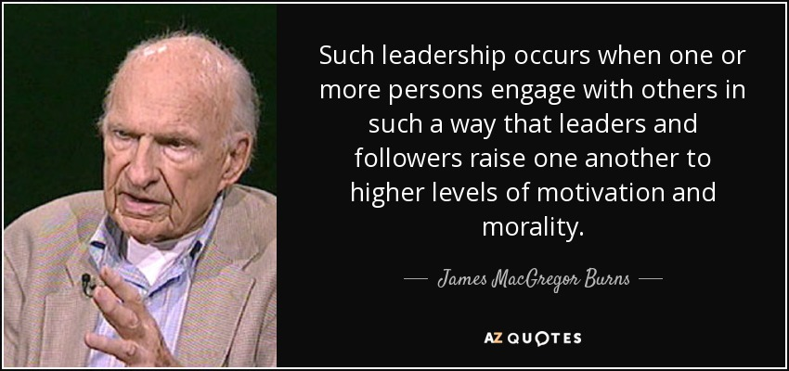
“LEADING FOR CHANGE IS NOT THE SAME AS EXERCISE OF POWER.”
-George McGregor Burns-
Notes:
We know that “leading for change is not the same as the exercise of power” (George McGregor Burns, LEADERSHIP 9-28).
Christian leaders don’t point loaded guns to the heads of the followers, to get them to do things they might not otherwise do. That is not practicing leadership; it is exercising power.
True leadership only exists if people follow when they have the freedom not to.

Slide 53
LEADERSHIP IN FAITH COMMUNITIES… THE TRANSFERENCE OF VISION!
Notes:
These visionary leaders find ways to transfer these dreams to their people. They understand that the test of true leadership is the transference of vision.

Slide 54
Good and godly people and a younger generation of Christians most often collide with their leaders over MISSION, TRADITIONS, VISION, VALUES, PRIORITIES AND PROGRAMS.
Notes:
SEE SLIDE: GOOD AND GODLY PEOPLE AND A YOUNGER GENERATION OF CHRISTIANS MOST OFTEN COLLIDE WITH THEIR LEADERS OVER MISSION, TRADITIONS VISION, VALUES, PRIORITIES AND PROGRAMS IN A FAITH COMMUNITY!

Slide 55
?
How do we LEAD
decisively and faithfully
when tensions arise
over change & transitions?
Notes:
So how do we lead with the mind of Christ when tensions arise over change and transitions?
The role of the visionary leader is to engage the congregation in shaping the new vision, and affirm passionately the core convictions.
Where do these disagreements and collisions take place most often in a local church?
Consider the following Lifespan graph of faith communities.

Slide 56
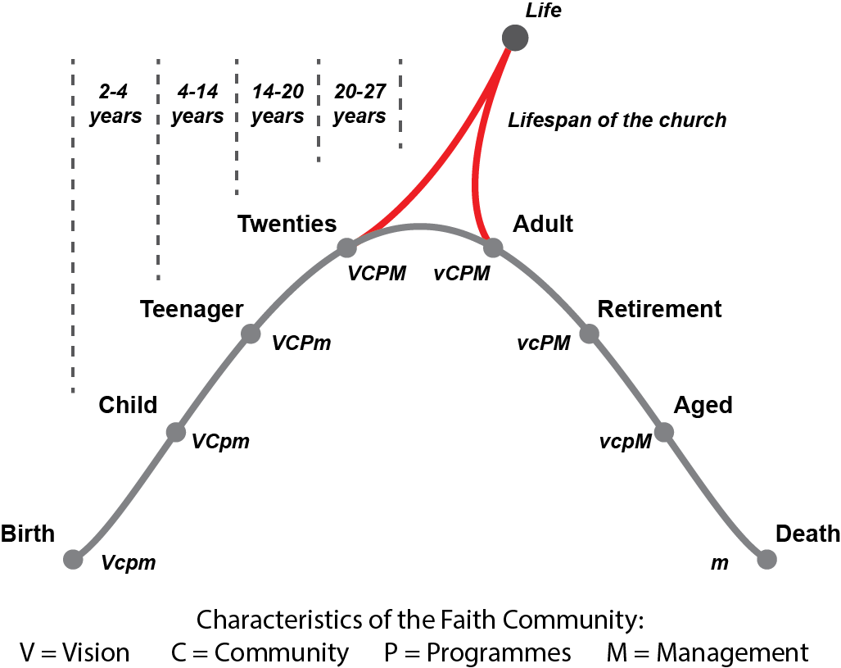
Life Stages of a Local Church
Notes:
LIFE STAGES OF A LOCAL CHURCH
CHARACTERISTICS OF A FAITH COMMUNITY: VISION
COMMUNITY
PROGRAMS
MANAGEMENT
THE MOST CRITICAL POINT IN THE LIFE CYCLE….!

Slide 57
Change is inevitable. Problems arise in the TRANSITIONS. We want and need for these transitions to be transformative; not destructive and divisive.
Notes:
CHANGE IS INEVITABLE.
PROBLEMS ARISE IN THE TRANSITIONS.
WE WANT AND NEED FOR THESE TRANSITIONS TO BE TRANSFORMATIVE;
NOT DESTRUCTIVE AND DIVISIVE.

Slide 58
Anchor # 1:
Speak Gracefully
—Ephesians 4:29—
Issue:
“Watch the words we speak” Principle:
Words we speak can bless
or “destroy” people
Notes:
Anchor #1: SPEAK GRACEFULLY. Ephesians 4:29
Issue: “Watch the words we speak.”
Principle: Words we speak can bless or “destroy” people.

Slide 59
As leaders, through the words we use, we either:
Encourage or discourage…
Lift them up or put them down…
Speak positively or negatively…
Focus on “them” or focus on self.
Notes:
“What comes out of my mouth reflects what is in my heart,” so Jesus states in the Gospels.
As leaders through the words we use, we either:
Encourage or discourage those with whom we work.
Lift them up or put them down.
Speak positively or negatively about them.
Reflect cultural sensitivity or cultural “blindness” to them.
Focus on “them” or focus on self.

Slide 60
?
How do others feel when they leave my presence?
Stronger or weaker?
Larger or smaller?
Confident or “scared”?
Understood or misunderstood?
Affirmed or manipulated?
Blessed or “destroyed”?
Notes:
I often ask myself: how do others feel when they leave my presence?
Stronger or weaker? Larger or smaller about themselves?
Confident or “scared”?
Understood or misunderstood? Affirmed or manipulated? Blessed or “destroyed”?

Slide 61
PRAISE to CRISTICISM ratio
80-90%
praise or positive statements
10-20%
criticism or negative statements
-Sven Walroos, clinical psychologist.
Notes:
“The praise to criticism ratio with others with whom we work should be at about 80-90% praise or positive statements to 10-20% criticism or negative statements.” Good advice from Sven Walroos, Scandinavian clinical psychologist.
According to Ephesians 4:29, God uses the words we speak to others within the Body of Christ to extend His grace through us to them!
What a powerful and probing thought!
Remember, the words we speak to those with whom we work especially those who differ and even collide with us, can bless them or destroy them.
Choose to bless them!

Slide 62
Anchor # 2:
Live Gratefully
—1 Thessalonians 5:18—
Issue: Comparison is the root of inferiority Principle: “Don’t complain. Be grateful”
Notes:
READ SLIDE AND SCRIPTURE PASSAGE

Slide 63
COMPARISON
robs us of joy, relationships, confidence and peace.
In the process, it saps our energy
and drains us of enthusiasm.
Notes:
Comparison is so pervasive in our society – in the workforce, the family, the local church or region, in our communities and particularly within ourselves.
We can feel good about ourselves – our gifts, talents and abilities – until we compare ourselves with the gifts, talents and abilities of other people.
We can believe our co-workers are adequate for the jobs we give to them until we compare their work – creativity, innovation, energy, collegiality – with others.
COMPARISON ROBS US OF JOY RELATIONSHIPS, CONFIDENCE AND PEACE.
IN THE PROCESS IR SAPS OUR ENERGY AND DRAINS US OF ENTHUSIASM.

Slide 64
Gratitude is the
“life-giving” antidote to the negative impact
of comparison
Notes:
Comparison can transform us from being a delightful district leader or local church pastor into a preoccupied, dejected, negative and disgruntled individual that other people only endure.
What is the antidote to comparison? Gratitude! Thankfulness! Appreciation!
We can choose to accept the people and provisions God in His wisdom has given to us.
We can choose to bring out the best in others through seeing the best in them.
In every situation, we can choose to be grateful, believing that God is in the midst of all that we are doing (I. Thessalonians 5:18).
Gratitude is the “life-giving” antidote to the negative impact of comparison.

Slide 65
Anchor # 3:
Listen Intently
—James 1:19—
Issue: “Seek first to understand” PRINCIPLE: Understanding, not agreement,
is the key to conflict management
Notes:
READ SLIDE AND SCRIPTURE PASSAGE
As a leader I may be a good administrator. However, I must be a great listener.
James 1:19 admonishes us to “quick to listen, slow to speak…!
I can listen for understanding. And listen for what is said. Also, I need to listen for what is not said.
Listening to the people with whom I work values them. They deserve to be heard. They may have the spiritual gifts needed to move the vision to action.
Remember, understanding not agreement, is the key to conflict management.

Slide 66
Theological vision
precedes
organizational vision.
Notes:
“Holiness people can have honest and intense differences.
I can tell you, after 35 years in higher education administration that good and godly people and a younger generation of Christians sometimes collide with their leaders over vision. And you have similar testimonies!
This is why I have come to see that theological vision (what I believe about people / what I “see” in them)
precedes organizational vision. ***(What I want for the church, district, field or region.)
“God give me your eyes to really ‘see’ the people with whom I work.”

Slide 67
Growth producing questions:
“What can I learn?”
“How can I change?”
Growth inhibiting questions:
“Why me?”
“What if…?”
Notes:
In conflict situations with Christians in our congregations, I have learned to ask two growth-producing questions:
“What can I learn? How can I change?”
Likewise, I have learned at least two growth-inhibiting questions:
“Why me? What if…?”
The questions make the difference in the outcomes: I, as the leader, can learn and change, even if others do not.

Slide 68
Anchor # 4:
Forgive Freely
— Luke 23:34 —
Issue: Be proactive in extending forgiveness PRINCIPLE: A spirit of forgiveness transforms
and empowers leaders
Notes:
One of my profound life lessons is this: forgiveness has little to do with the external environment around me, and everything to do with my “internal” condition!
Extending forgiveness does not wait for the “other” to request forgiveness. Remember the example of Jesus on the cross: “Father, forgive them, they know not what they do.”
Was Jesus naïve? Did he really believe that those who were killing him did not know what they were doing? No!
Did Jesus believe that by extending forgiveness, those who were slandering him and hurting him would cease their activity? No!

Slide 69
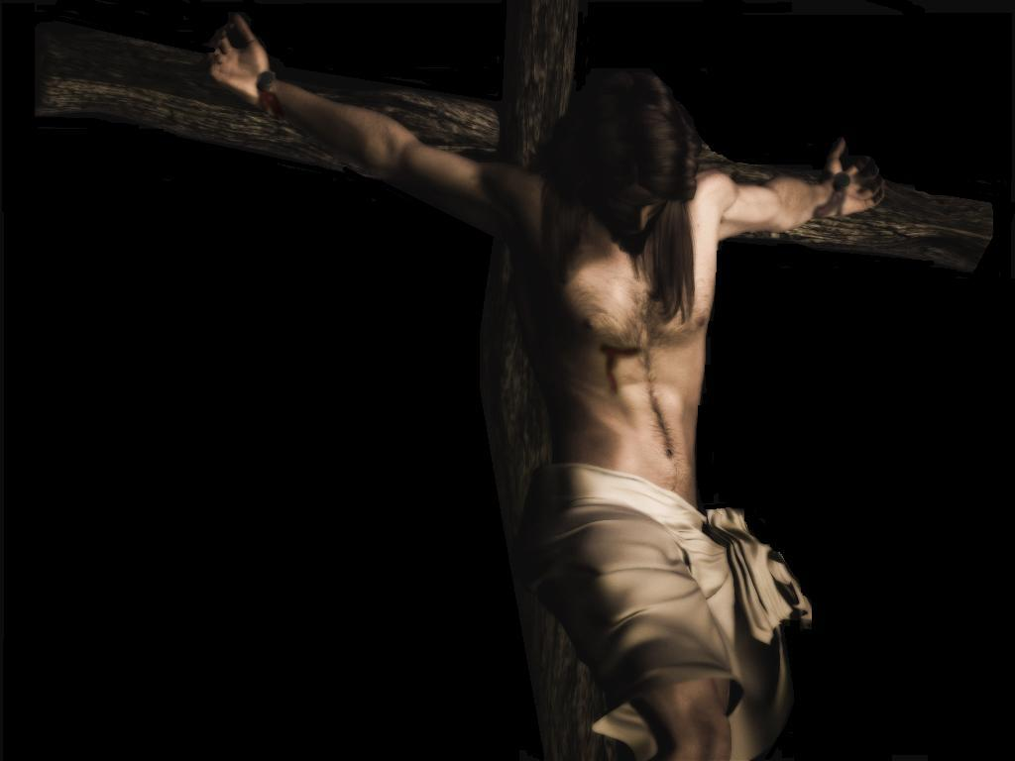
“Father, forgive them, for they do not know what they are doing.”
Luke 23:34 (NIV)
Notes:
Jesus was not going to permit what others said against him or the evil they did against him to create a bitterness or resentment within him and thereby create a rupture on the relationship with God His Father. It simply was not worth it!
“Father, forgive them, they know not what they do!”
Extending forgiveness frees me from bondage to the other person. Too often, we permit persons who have offended us to control us.

Slide 70
Anchor # 5:
LEAD Decisively
— Romans 12:8c —
ISSUE: Christian leaders combine deep humility,
clear vision, and intense resolve PRINCIPLE: Our holiness testimony is reflected in and through the way we make and implement decisions
Notes:
READ SLIDE AND SCRIPTURE.
It is in the tension within a faith community between our preferred future and the present reality that our decision making as leaders most often takes place.
It is in this context that we live, work and lead.
If holiness of heart does not reflect itself in these situations where good and godly people differ over vision and values, then our holiness testimony is only a doctrine and not a Life within us!
Respecting our brothers and sisters in Christ, especially those with whom we differ— even collide with us—is at the heart of what it means to lead with the Mind of Christ.
It is in these times of conflict over vision and values that decisions will need to be made —even when continuing differences exist. And, in these times, we will lead—lead decisively—but from our knees and often with a weeping heart!
Again, at some point in our leadership responsibilities, decisions have to be made. Decisions made after prolonged individual and collective prayer. Decisions made with fierce resolve and deep humility.

Slide 71
They give passionate attention
to the leadership roles of:
Dreaming and planning
Organizing and administering
Motivating and encouraging
Evaluating and reviewing
Notes:
Pastors are the catalysts for evangelism and discipleship, change and action in the local congregation.
If decisive leaders are to move from the preferred vision to achieved results, they must give passionate attention to the leadership roles of:
Dreaming and planning. Organizing and administering. Motivating and encouraging. Evaluating and reviewing.
The apostle Paul challenges us, “if (your gift) is leadership, let him govern diligently” (Romans 12:8c)

Slide 72
PLANNING CYCLE
1.Understand your mission:
OVERARCHING
MISSION STATEMENT
PLANNING CYCLE
4. Implement
your plan:
COMPREHENSIVE IMPLEMENTATION PLAN
Continually review and revise your strategy
REVIEW AND REVISE
2. Assess your situation:
SITUATION ASSESSMENT
3. Develop your goals:
PERSONAL PROFESSIONAL GROWTH GOALS
Notes:
Let’s focus for a few moments only on the critical leadership function of dreaming and planning.

Slide 73
We move ahead – decisively – through:
PRAYER, with them, for them and for “me” as leader;
COLLABORATION, involving them when and where we can in the process; and with
GRATITUDE, thanking God, and “them” for their gifts, talents, abilities and testimonies of faith.
Notes:
Sometimes, perhaps often, we must move ahead without everyone within the community agreeing with the vision or direction to be taken.
How do we move ahead, decisively, in these painful situations while, at the same time, show Christian respect to those who differ with us? We move ahead decisively –
THROUGH prayer, with them, for them and for “me” as leader; THROUGH collaboration, involving them when and where we can in the process;
and WITH GRATITUDE, thanking God, and “them” for their gifts, talents, abilities and testimony of faith in Jesus as Lord.
In this spirit of humility and brokenness, we move ahead: Confidently – believing that God is working in the midst of this difficult situation, and decisively, not with paralysis or uncertainty, but with the conviction that God has spoken his word of vision and direction. A conviction that He will continue to lead His people to action even though the circumstances or attitudes may not give evidence of His work at the present time.
This is leading with the mind of Christ – leading decisively in the midst of complex and difficult situations.
Remember, the BIG question for Christian leaders: “How can my ministry of Christian leadership enable others to fulfill their ministry to each other and their mission in the world?”

Slide 74
Anchor # 6:
Love Deeply
—1 Thessalonians 2:7—
ISSUE: Value people not power (or position) PRINCIPLE: The evidence of leadership is seen
in the lives of the followers
Notes:
read slide and scripture.
Caring for others is the mark of greatness, not decisiveness. Paul reminds his follows in I Thessalonians 2:7 that “we were gentle among you, like a mother caring for her little children.”

Slide 75
Leaders who inspire others… _____ #1. Set Clear Standards
(or Expectations) ___ #2. Expect the Best ___ #3. Pay Attention ___ #4. Encourage People ___ #5. Tell the Story ___ #6. Celebrate Together ___ #7. Set the Example
ENCOURAGING THE HEART James Kouzes and Barry Posner
Notes:
One book on encouraging those with whom we work tells us how to encourage the hearts of our co-workers:
#1. Set Clear Standards
#2. Expect the Best
#3. Pay Attention
#4. Encourage Often
#5. Tell the Story.
#6. Celebrate Together.
#7. Set the Example.
See other suggestions in the book, ENCOURAGING THE HEART by Kouzes and Posner

Slide 76
Anchor # 7:
Pray Earnestly
— 1 Thessalonians 5:17 —
Issue: Some issues are resolved only through prayer
and dependence on God Principle: Recognize that God can work in us
to become the change we desire to see in others
Notes:
READ SLIDE AND SCRIPTURE
Holiness leaders know that we do not have the power to change others. Change can take place, however, within us!
In the midst of experiencing honest and intense differences between good and godly people, the “pray-er” can be changed and transformed!
Conflict situations can produce growth. They can also inhibit growth in the lives of leaders.
Before God in prayer, we seek answers from Him to these two questions: what can I learn; how can I change?

Slide 77
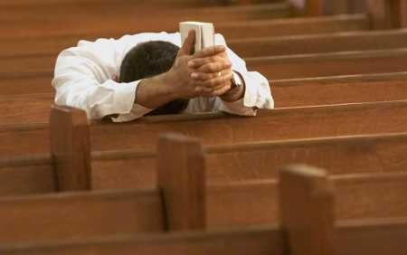
In the midst of experiencing honest and intense differences
between good and godly people, the “pray-er” can be changed and transformed!
Notes:
In so asking, and seeking God’s answers to these two questions for our lives as leaders, we are changed! Increasingly, we become the change, by God’s grace, we desire to see in others.
Others around us may or may not be impacted by what happen within us. But, what happens to us is transformative!
We grow. We change. We mature. We increasingly exemplify the change we desire to see in others!
And, in the process, we experience the peace of God which transcends understanding. In the process, we are “freed” from insisting on change within others.
Through earnest prayer, caring leaders asks the right questions, and trust God with the results...even as we are changed in the process! Amen!

Slide 78
“Leaders with the mind of Christ seek to humbly lead others, for the purpose of inspiring and enabling them, through teaching and example, to live their lives under the Lordship of Christ, and to understand, accept, and fulfill their ministry to each other, and their mission in the world.” ELF- Definition of Christian Servant Leadership
Notes:
“Leaders with the mind of Christ seek to humbly lead others, for the purpose of inspiring and enabling them, through teaching and example, to live their lives under the Lordship of Christ, and to understand, accept, and fulfill their ministry to each other, and their mission in the world.” ELF- Definition of Christian Servant Leadership

Slide 79
Anchors hold the servant leaders steady in the tensions and transitions in our leadership responsibilities: 1. Speak Gracefully. Watch our words 2. Live Gratefully. Don’t complain, be grateful 3. Listen Intently. Seek first to understand 4. Forgive Freely. Be proactive in forgiving 5. Lead Decisively. With vision, humility and resolve 6. Love Deeply. Value people, not power 7. Pray Earnestly. Become the change
Notes:
ANCHORS HOLD US STEADY IN THE TENSIONS AND TRANSITIONS IN OUR CONTEMPORARY MINISTRY:
1. Speak Gracefully. Watch our words 2. Live Gratefully. Don’t complain, be grateful 3. Listen Intently. Seek first to understand 4. Forgive Freely. Be proactive in forgiving 5. Lead Decisively. With vision, humility and resolve 6. Love Deeply. Value people, not power 7. Pray Earnestly. Become the change

Slide 80
Question #1
?
Which of these seven anchors
is your greatest strength?
Notes:
IN CONCLUSION
I leave you with these questions:
Which “Anchor” is your strength? Be honest with yourself and God.
It’s vitally important for us to affirm our strength even as we acknowledge our need.
Build on your strength.

Slide 81
Question #2
?
On which one of these “anchors” do you need most to focus in your contemporary leadership ministry?
Notes:
Which one of these “essentials” or “anchors” do you need most right now in your leadership assignment? Work on your need.
Pray for that specific anchor you need, and give thanks for strength He has given to you as you lead your people from vision to action to results.
As you experience the tension between the vision God has given you and the reality of your present situation, in which of these areas do you most need God to hold you steady?
As you embrace tension and transitions and move from vision to results, what is your greatest need?

Slide 82
Question #3
?
What difference would it
make in your ministry if
you intentionally embrace
this anchor?
Notes:
ONE MORE QUESTION. WHAT DIFFERENCE WOULD IT MAKE IN YOUR MINISTRY IF YOU INTENTIONALLY EMBRACE THIS (WEAK) ANCHOR?

Slide 83
“Our testimony of faith in
Jesus Christ must increasingly inform and transform the
way we lead and live
in our homes
and organizations.”
Notes:
AS CHRISTIAN LEADERS, “OUR TESTIMONY OF FAITH IN JESUS CHRIST MUST INCREASINGLY INFORM AND TRANSFORM THE WAY WE LEAD AND LIVE IN A FAITH COMMUNITY”

Slide 84
III. Questions & Discussion

Slide 85
Dr. Edward LeBron Fairbanks
www.BoardServe.org

